Slide 1
AR Safety Mirror:
Advancing Cyclists' Rear Hazard Awareness with AR Camera
Martin Karastoyanov, Jueon Park, Wonseok Jang
Team 1
Date
23 September, 2025

Slide 2
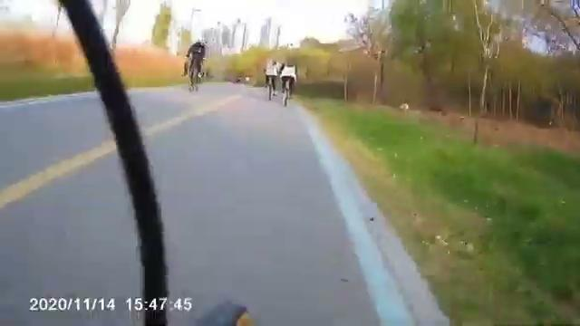
Motivation
How do cyclists monitor their rear surroundings for potential hazards?
Traditional Mirrors
Limited field of view, prone to vibrations.
Head Turns
Loss of forward vision, unstable riding.
Missing Alerts of Others
Can miss signals due to noisy outdoor environment
Need for Rear Awareness
Traditional solutions often fall short in providing comprehensive and safe rearward visibility

Slide 3
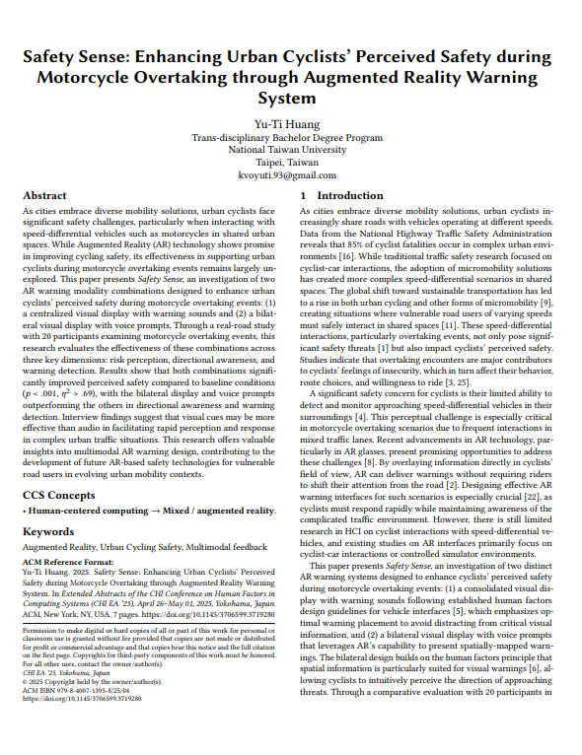
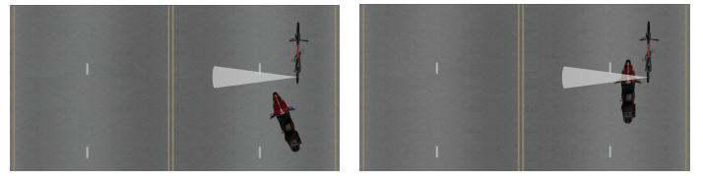
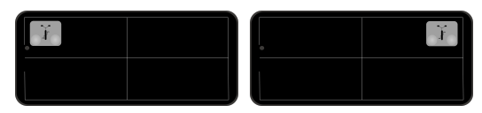
Motivation: Existing Paper
(1) Detection: ultrasonic sensor to detect overtaking motorcycles on the left/right side
(2) Alerts: visual display + warning sounds on AR glasses

Slide 4



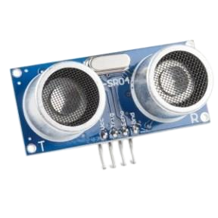


Limitations
Limited Field of View
Inability to Differentiate
Short Detection Range
Ultrasonic sensors has a narrow detection cone, only a partial view of the cyclist's rear surroundings. This can lead to blind spots and missed threats.
The current UI only shows that something is nearby, so riders still need to look back to see what it is
With a maximum range of only 4m, users have very little time to react to approaching hazards.
HC-SR04 Ultrasonic sensors with 4-meter max range

Slide 5



Objectives
Enhanced
Hazard Detection
Informative
Mirror Interface
No 'Look-Back' Behaviour
Camera for a significantly wider field of view and visual representation of the hazards, not just their presence.
Familiar back-mirror interface with comprehensive information of potential hazards
=> direction, proximity
No longer need to physically turn their heads, keeping forward focus and stability.

Slide 6
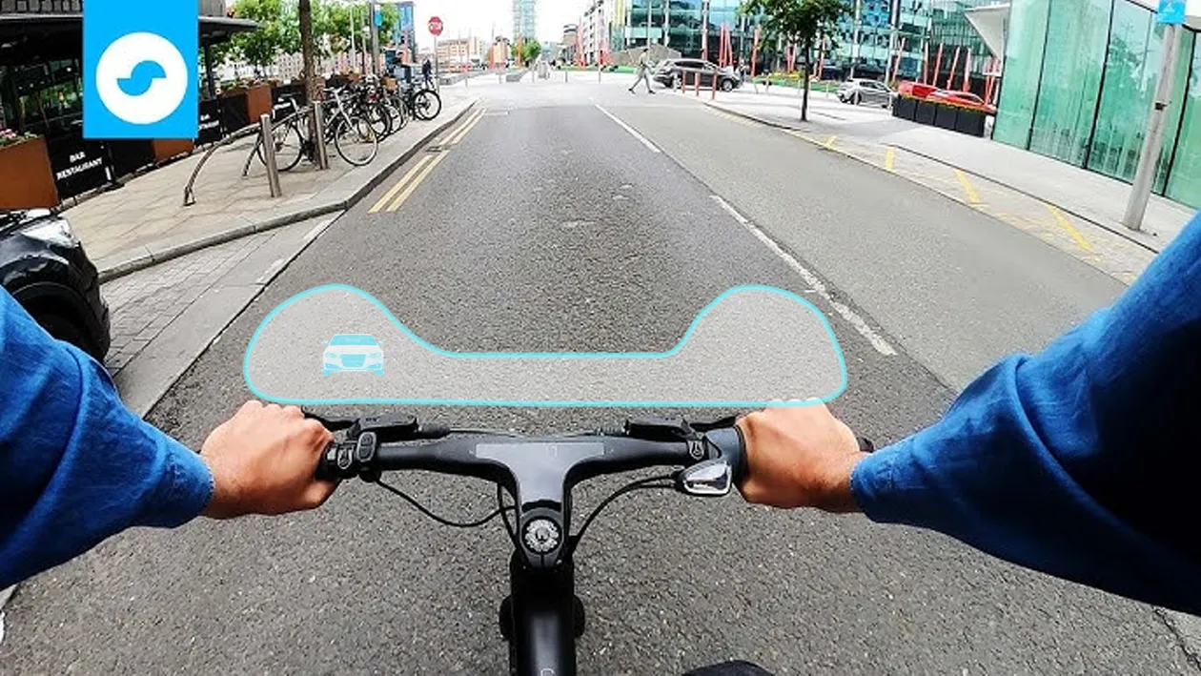
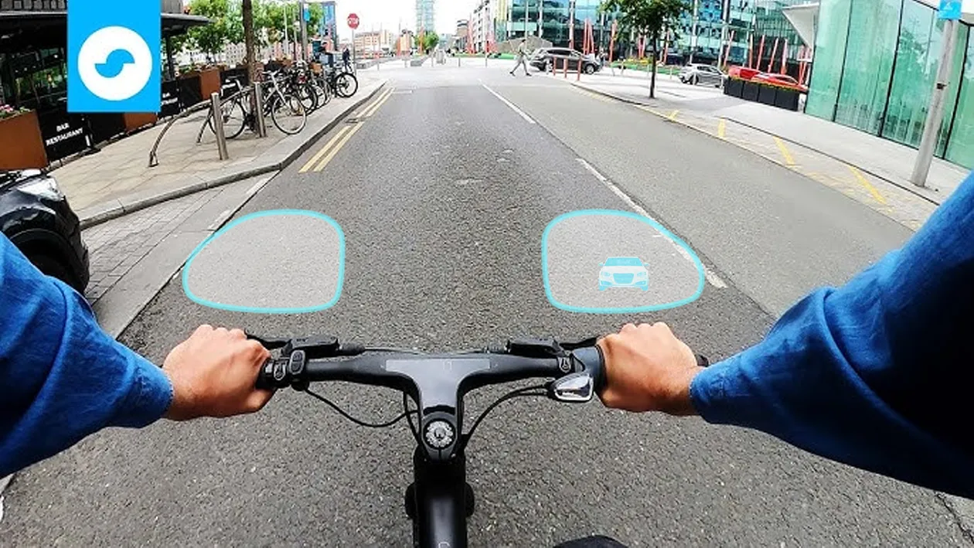
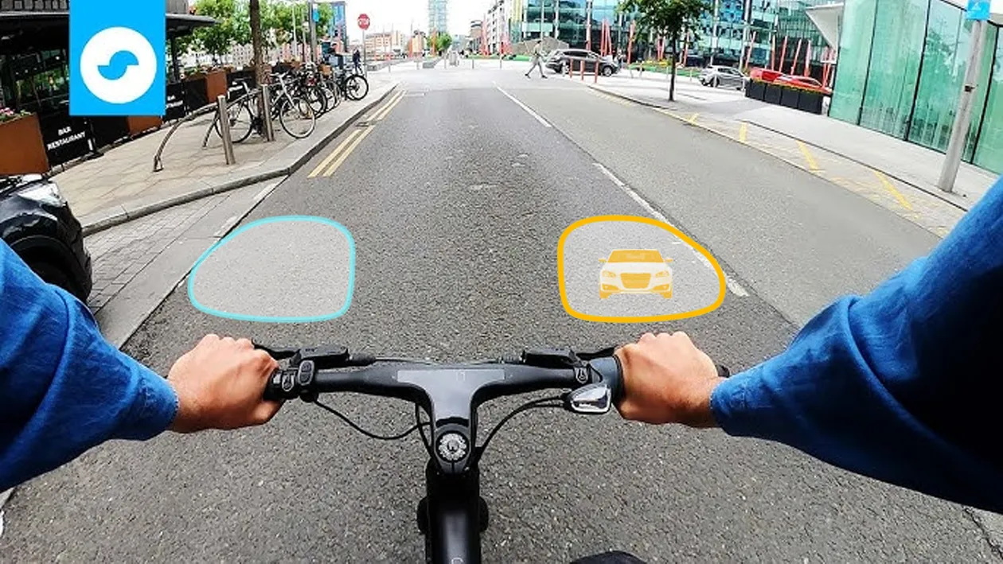
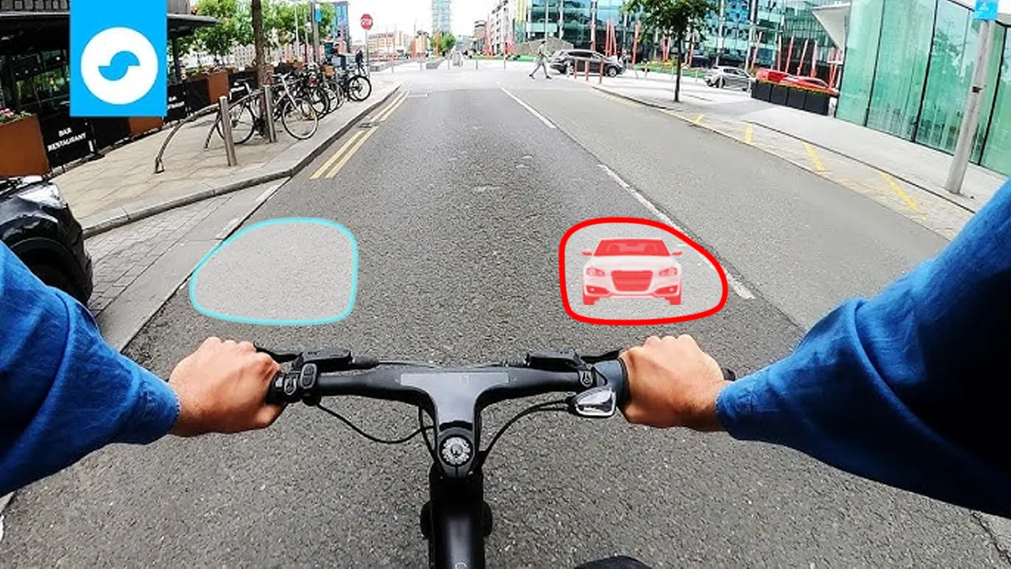
Design
Camera + Mirror-like Interface
Therefore, our project integrates camera and an familiar back-mirror AR interface to offer superior rear situational awareness and reduce cognitive burden.

Slide 7
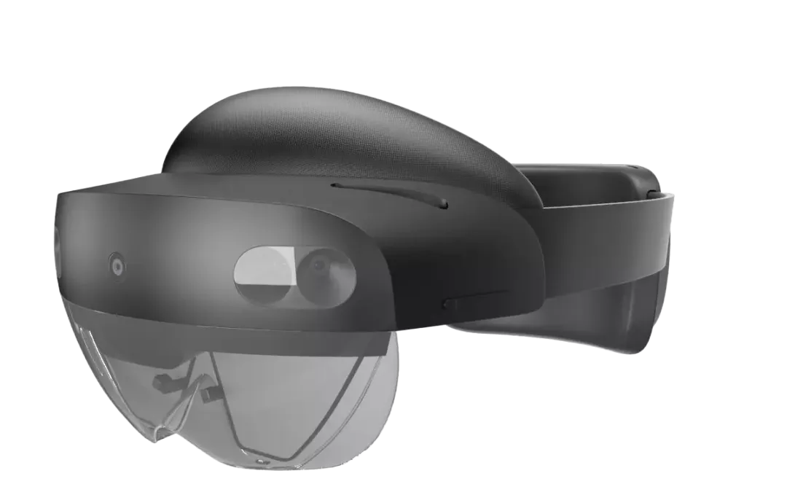
Methodology and Approach
Research Questions
RQ1: How do different AR rearview mirror visualisation designs influence cyclists’ perception of rear hazards in a simulated virtual reality environment?
RQ2: How does an AR rearview mirror-style interface influence cyclists’ perception of overtaking motorcycles compared to simple directional rear hazard warnings?
System
UI Design - Comparison Needed!
Fixed UI
Visual cues relative to handlebars, dynamically moving with perspective.
Color and size indicate proximity.
Anchored UI
AR: Microsoft Hololens
Camera: GoPro, BIKET, SEWEEK
App: Unity
Cues fixed on display.
semi-transparent by default, becoming opaque upon hazard detection.
Variance UI
alternative visual styling (shapes, patterns, animations).
No transparency adjustment needed.

Slide 8
Literature Review
1. Safety Sense: Enhancing Urban Cyclists’ Perceived Safety during Motorcycle…
Our project directly addresses the limitations of "Safety Sense.", by enhancing existing UI and possibly sensing system.
(Huang, Y.-T. CHI 2025)
2. ProxiCycle: Passively Mapping Cyclist Safety Using Smart Handlebars for Near-Miss Detection
This paper collects ‘close-pass’ data between car and bicycle to build a safety map. It’s a macro-level data for long-term route, whereas ours is a micro-level system for immediate hazard avoidance (Joseph Breda et al. CHI 2025)
3. The Impact of Augmented Reality-Based Visual Alerts on the Safety and Experience of E-bike riders
This study used a VR cycling simulator to test different AR visual alerts, giving us useful test conditions such as reaction time, perceived safety, and cognitive load (Junyao Fan et al. Cross Cultural Design HCII 2025)
4. Bicycle crash contributory factors: A systematic review
This paper addresses that biker’s inattentiveness is one of a major crash causes, which validates our motivation.
(Salmon, P. M. Safety Science 2022)
5. Safety Performance Assessment via Virtual Simulation of V2X Warning Triggers…
The paper provides cyclist behavioral model for evaluating virtual safety simulation
(Lars Schories et al. Sustainability 2024)

Slide 9



Contribution
New AR Interface
Sensing System
Cognitive Load
Evaluation of an AR rearview mirror interfaces tailored for cyclists
Integration of camera with object detection/periodic display strategy
By eliminating the need for ‘Look Back’ head turns, we anticipate cyclists to maintain focus on the road ahead.

Slide 10
Tentative Schedule
Week | Period | Activity
1 | 9/29 - 10/5 | Finalise research questions and scope, basic system design
2 | 10/6 - 10/12 | Finalise the detailed design and visualisation guidelines for the AR rearview mirror interface. (Size, color, hologram effects, information display methods, etc.)
3 | 10/13 - 10/19 | Development of Sensor Integration and Data Processing Modules and internal testing of sensor reliability
4 | 10/20 - 10/26 | AR Interface Development (Visualisation); Hazard Detection and Feedback System Integration; Refinement of the design based on early tests
5 | 10/27 - 11/2 | Initial prototype testing and debugging; Iteration cycle 1: refine prototype
6 | 11/3 - 11/9 | Experimental Protocol Design and incorporate feedback from prototype iteration
7 | 11/10 - 11/16 | Experimental Environment Setup and Preliminary Testing; Iteration cycle 2: refine setup/interface
8 | 11/17 - 11/23 | Experiment execution and data collection
9 | 11/24 - 11/30 | Data analysis and derivation of results
10 | 12/1 - 12/8 | Finalising the paper

Slide 11
Thank You !

Slide 12

Questions?

